Slide 1
Agentic AI Hackathon: Building Intelligent Agents with IBM Granite and LangFlow
AI-Assisted Remote Patient Monitoring (RPM) Support System

Slide 2
Name of the team: AI PLUNGE
Details of Team members
TEAM MEMBER NAME | Recent Passport Photo | Email ID | Phone number [WhatsApp]
Gavin Darius Addison J |  | gavindarius.ci23@bmsce.ac.in | 9538423688
Pranati A P |  | pranatiap.ci23@bmsce.ac.in | 7975246491
Niharika Rao K |  | niharikarao.ci23@bmsce.ac.in | 9663127235

Slide 3
Problem statement (The Challenge)
"The Silent Crisis in Home Healthcare"
The Data Tsunami: Modern wearables generate thousands of data points daily. Healthcare providers are drowning in noise, leading to "Alert Fatigue"—where critical warnings are ignored because of false alarms.
The Latency Trap: Current systems are reactive. By the time a doctor notices a deterioration trend manually, the patient is often already in critical condition.
Resource Burnout: High hospital readmission rates occur simply because there is no scalable way to monitor patients effectively outside clinical walls.
The Gap: We lack an intelligent "Filter" that bridges the gap between raw sensor data and clinical decision-making.

Slide 4
Proposed solution
"Meet Granite-Guard: An Agentic Defense System"
Core Concept: An autonomous tri-agent system that monitors, analyzes, and acts in real-time.
The 3-Agent Architecture:
  The Analyst: Normalizes raw JSON streams into readable health summaries.
  The Detective (Risk Agent): Compares current vitals against historical baselines to detect subtle deterioration.
  The Guardian (Guidance Agent): Provides safe, RAG-grounded advice to patients.
Tech Synergy: Built on LangFlow for orchestration and IBM Granite for trustworthy, enterprise-grade reasoning.
Key Feature: "Zero-Click Dispatch" – The system can autonomously trigger an ambulance API call if the Emergency Score exceeds a critical threshold (e.g., >85/100).

Slide 5
Need of project
"Why This Matters Now"
Proactive vs. Reactive: We are shifting the paradigm from treating sickness to preserving health.
Scalability: A single nurse can currently monitor ~20 patients. With Granite-Guard's intelligent filtering, one nurse can effectively monitor 200+ patients, focusing only on those flagged by the AI.
Clinical Safety: Unlike generic chatbots, our system uses RAG (Retrieval-Augmented Generation). Every piece of advice is cross-referenced with uploaded medical guidelines (AMA/AHA standards), drastically reducing AI hallucinations.
Economic Impact: Reduces costly emergency room visits and hospital readmissions.

Slide 6
End user of project
"Tailored Views for Every Stakeholder"
👩‍⚕️ For Doctors: A "Command Center" dashboard. They see rapid deterioration trends, override AI alerts, and view deep clinical history.
🏥 For Nurses/Front-Desk: A prioritized "Watch List." Patients are ranked by Emergency Score, allowing staff to triage resources instantly.
👨‍👩‍👧 For Families: A "Peace of Mind" app. They receive simplified status updates (e.g., "Dad is stable") without confusing medical jargon, compliant with HIPAA privacy rules.
🚑 For Emergency Services: Automated, data-rich dispatch requests containing location, vital history, and suspected condition code.

Slide 7
Technology Used
"Built on Trustworthy AI"
Orchestration Engine: LangFlow – Enables visual chaining of complex logic and rapid prototyping of agent behaviors.
The Brain (LLM): IBM Granite (ibm/granite-13b-chat-v2) – Chosen for its superior performance in enterprise tasks and lower tendency for hallucination compared to creative models.
Storage & Ingestion: IBM Cloud Object Storage – Secure, scalable repository for continuous IoT JSON streams.
Knowledge Base (RAG): Astra DB / Watsonx.ai – Stores vectorized clinical guidelines for the AI to "consult" before answering.
Interface: Streamlit – For rapid deployment of a responsive, Role-Based Access Control (RBAC) dashboard.

Slide 8
Novelty and Uniqueness
"What Sets Us Apart?"
Hybrid Validation Logic: We don't rely solely on the LLM. We combine Deterministic Math (Emergency Score Formula) with Probabilistic AI (Granite Reasoning). This creates a "Double-Check" mechanism for safety.
Dynamic Role-Based Masking: The UI dynamically changes the data granularity based on the user login. This is a first-of-its-kind feature in hackathon RPM systems, directly addressing HIPAA "Minimum Necessary" standards.
The Feedback Loop: Our three agents talk to each other. The Analyst's summary informs the Detective's risk score, which informs the Guardian's advice.
Live Simulation: Our prototype isn't static; it handles live data injection to simulate a cardiac event in real-time.

Slide 9
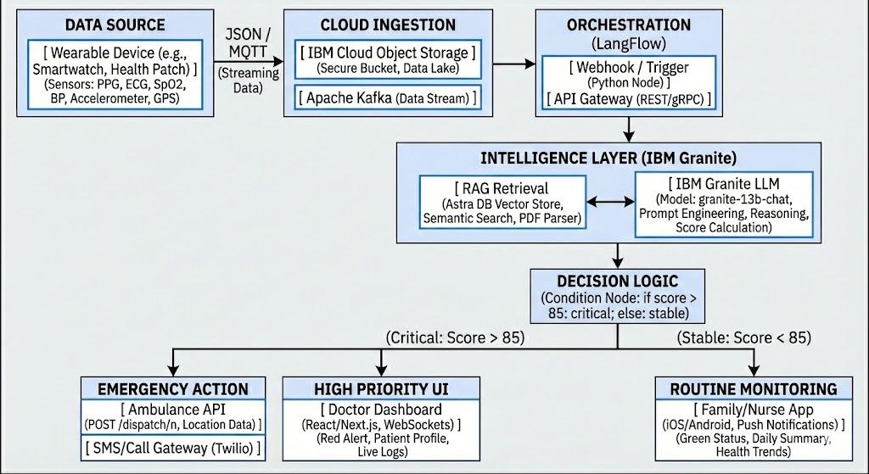
Technical flow diagram - Architecture blueprint
Step 1: Ingestion: Wearable pushes JSON Data to IBM Cloud Bucket.
Step 2: Trigger: LangFlow Webhook detects new file and Initiates Pipeline.
Step 3: Retrieval: RAG Node fetches "Cardiac Guidelines" from Vector Store.
Step 4: Reasoning: IBM Granite analyzes Vitals + Guidelines.
Step 5: Decision:
If Score > 85: Trigger Ambulance Webhook + Red Alert.
If Score < 85: Update Database + Green Status.

Slide 10
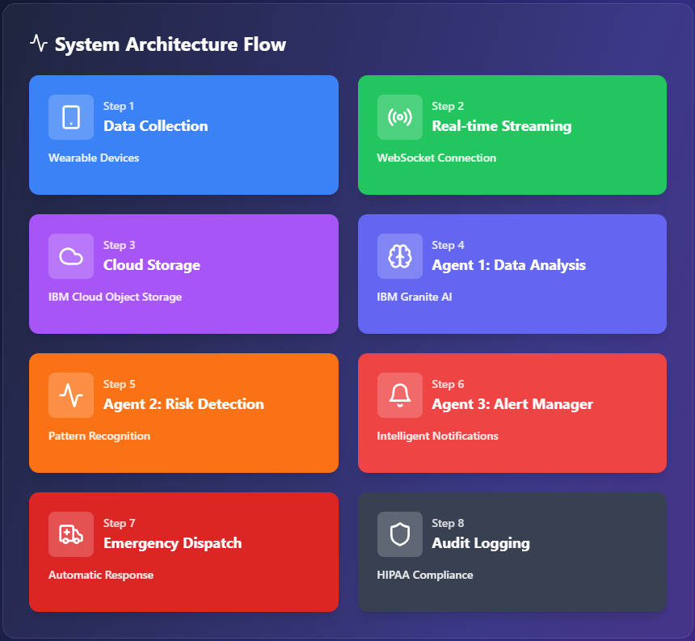

Slide 11
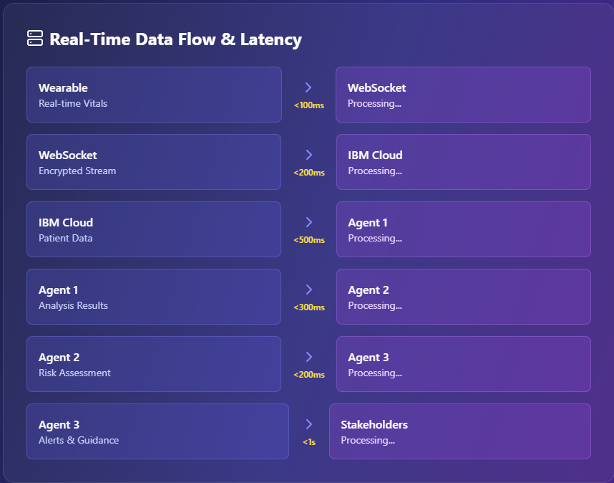

Slide 12
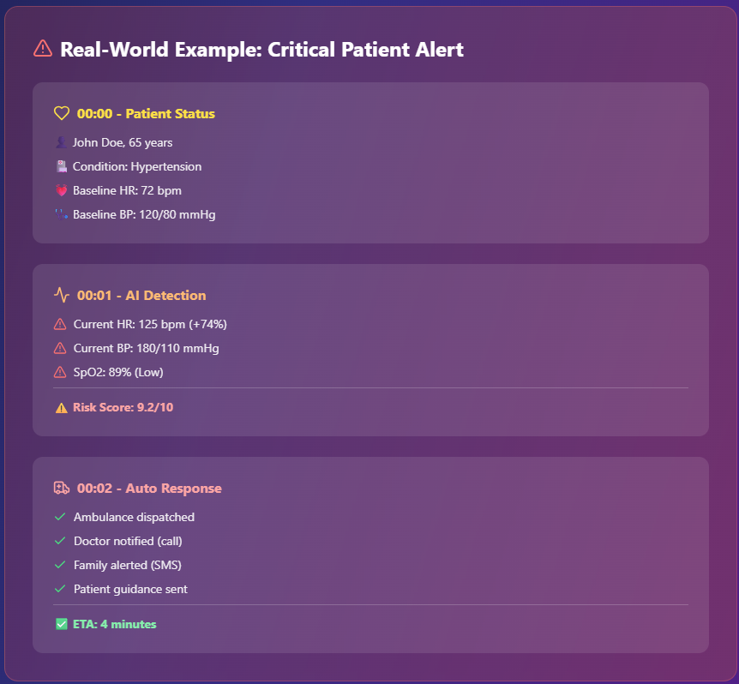

Slide 13
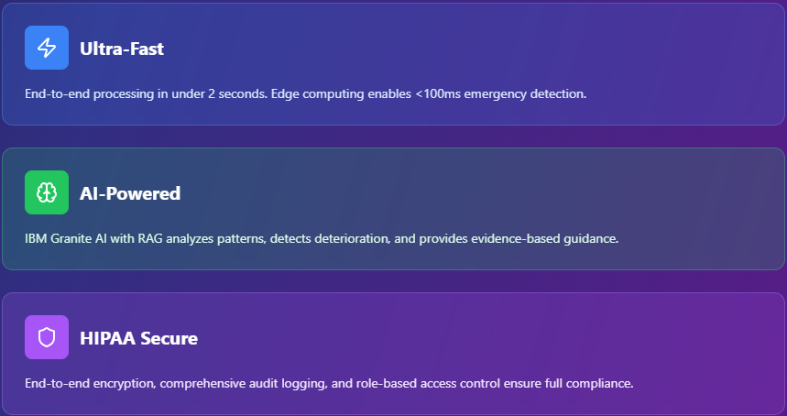

Slide 14
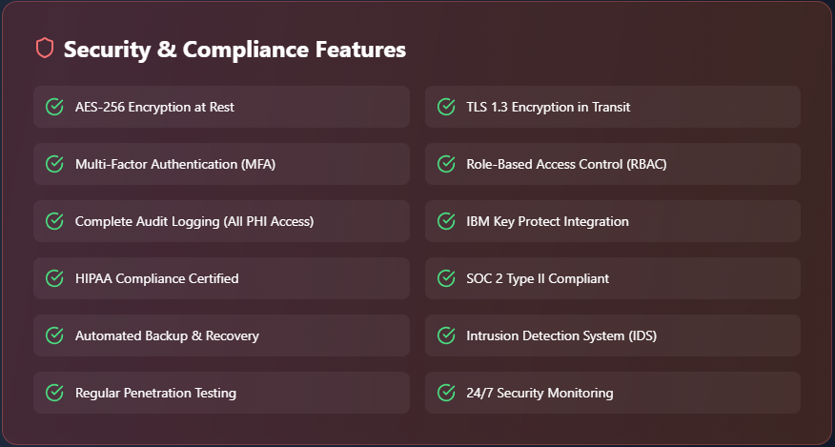

Slide 15
Langflow component Used
Webhook / Chat Input: The "Listener." It accepts the incoming JSON payload from the mock wearable device.
Prompt Template: The "Translator." It formats the raw JSON into a natural language prompt:
"Patient X has HR 140. Guidelines say Y. Analyze risk."
IBM watsonx AI Agent: The "Brain." Configured with granite-13b-chat,
temperature 0.1 (low creativity) for strict medical analysis.
Astra DB (Vector Search): The "Library." Retrieves specific paragraphs from the Remote Patient Monitoring Playbook relevant to the current symptoms.
Conditional Router: The "Traffic Cop." Uses logic (if emergency_score > 85) to route the flow down the Emergency path or the Routine path.
HTTP Request Tool: The "Hand." Sends the POST request to the external ambulance dispatch system.

Slide 16
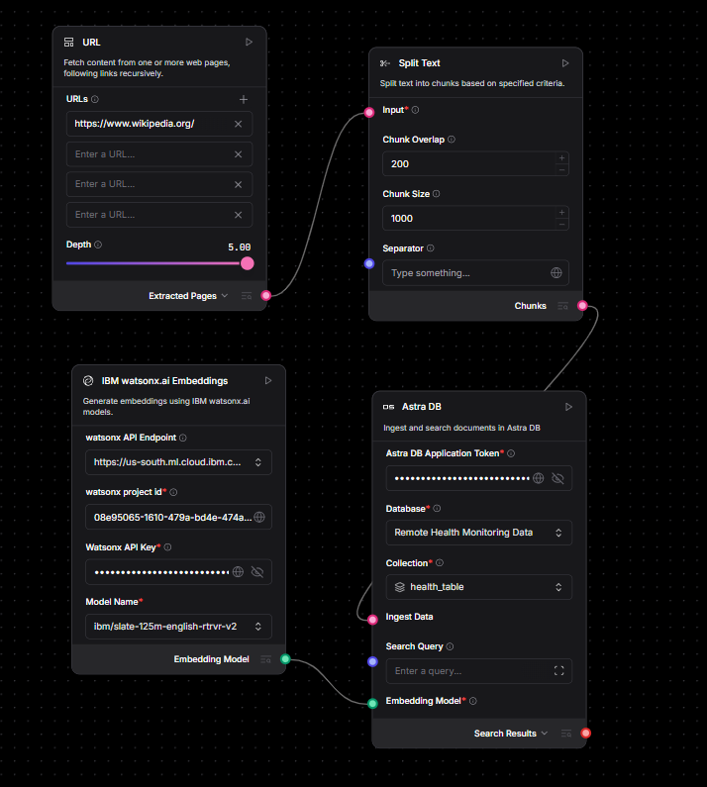
RAG Implementation in LangFlow

Slide 17
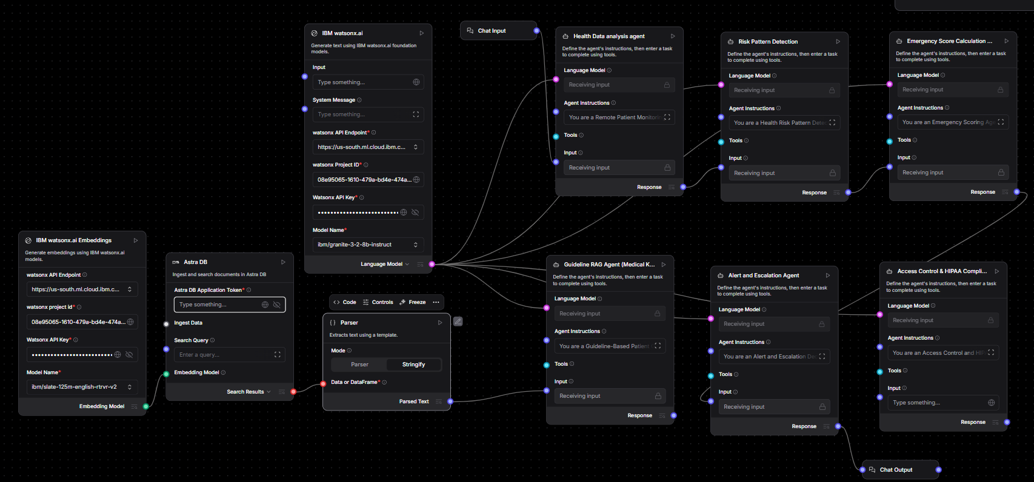
Input Screenshot 2

Slide 18
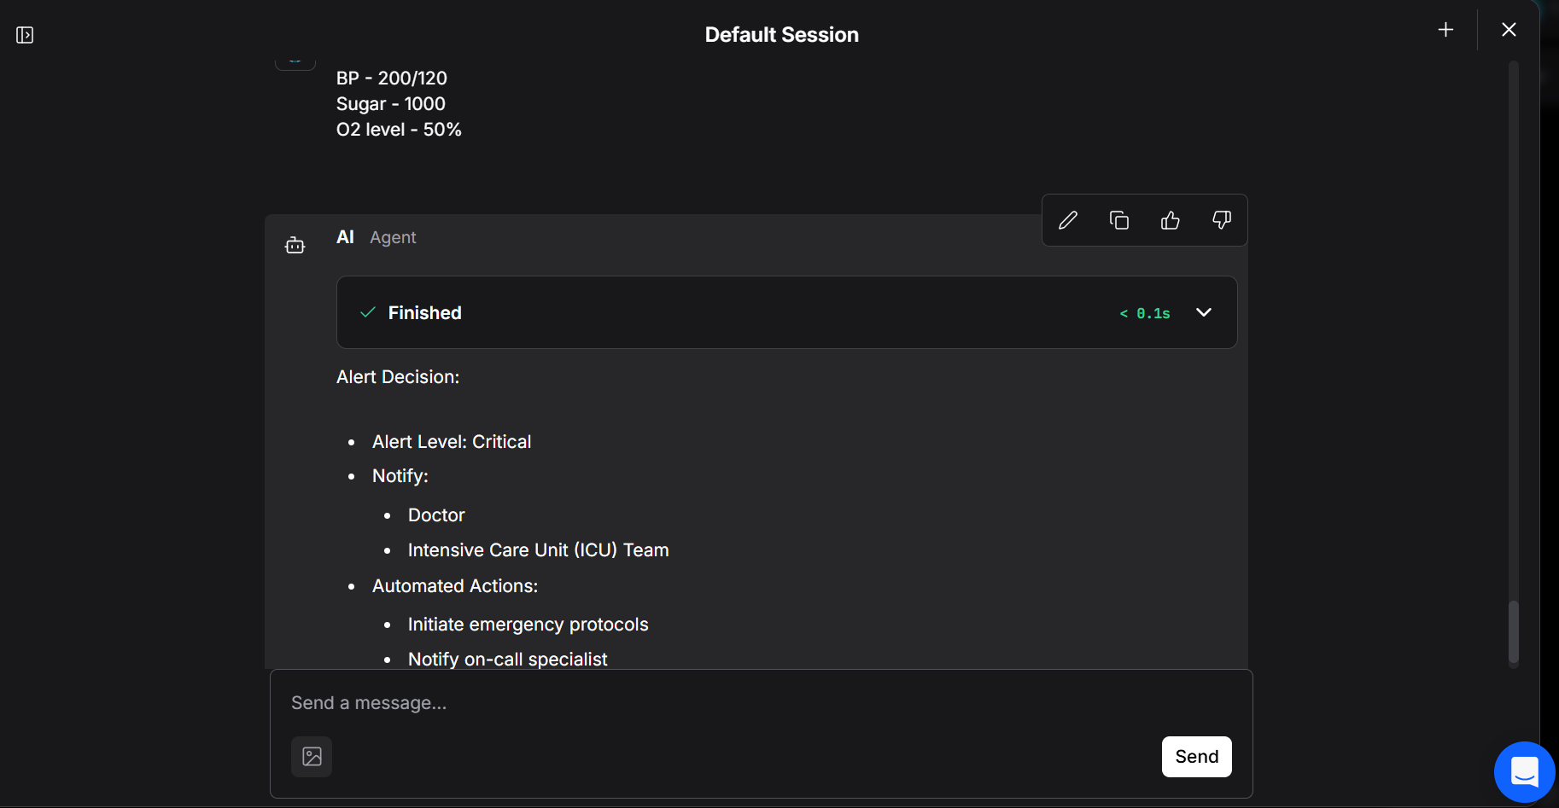
Output Screenshot 1

Slide 19
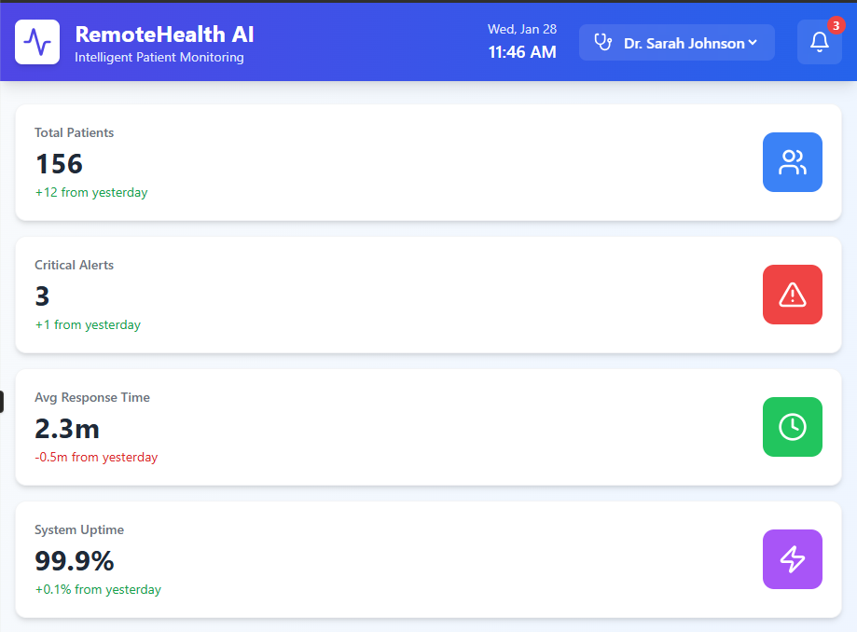
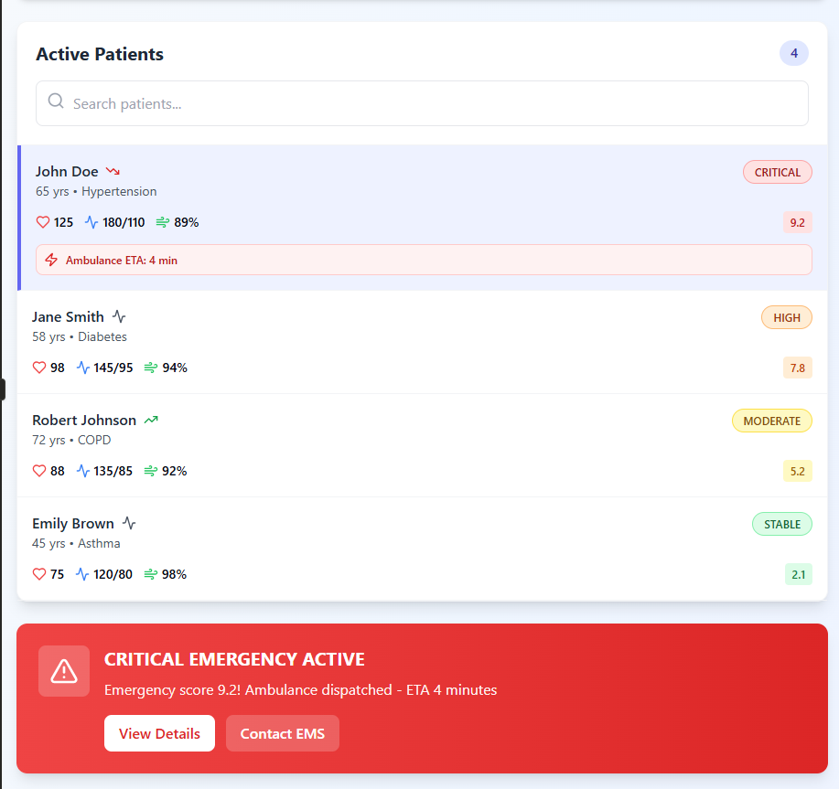
Web Application for Doctor

Slide 20
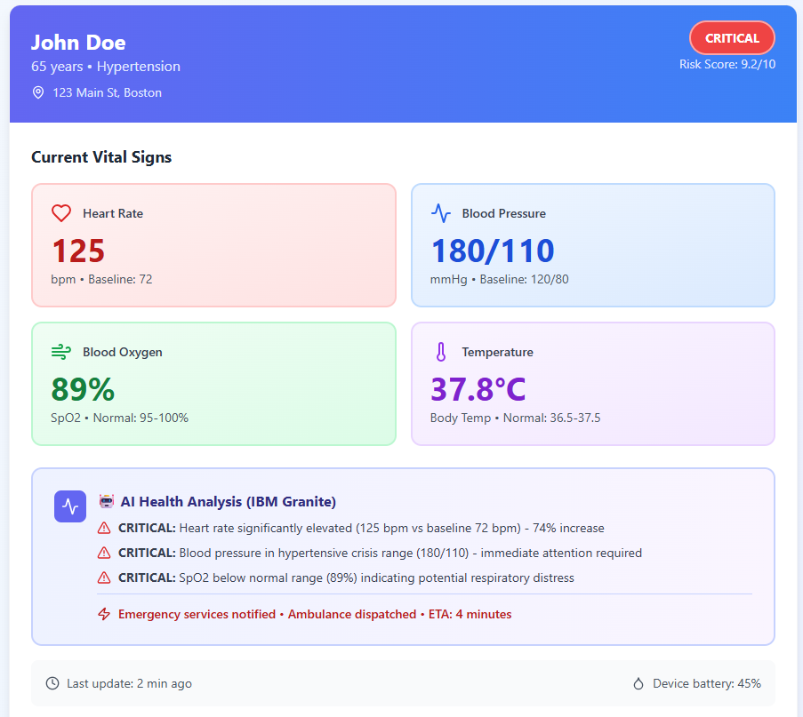
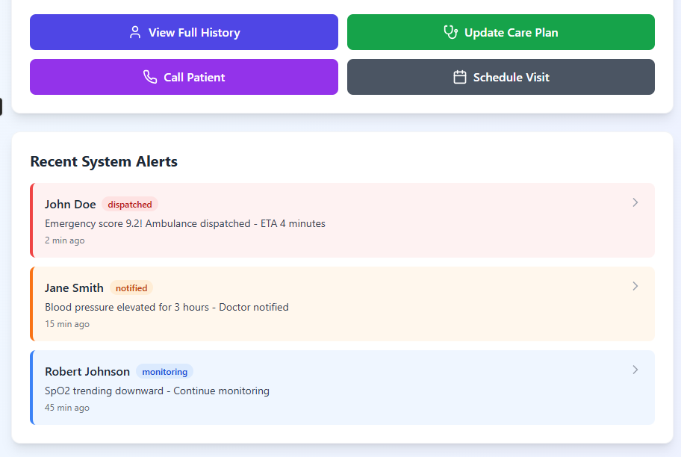

Slide 21
Future Scope
"Roadmap to Production"
Short Term:
  EHR Integration: Using HL7/FHIR standards to write these alerts directly into hospital systems like Epic or Cerner.
  Multi-Lingual Support: Leveraging IBM Granite’s translation capabilities to offer patient guidance in Spanish, Hindi, and Mandarin.
Long Term:
  Predictive AI: Moving from detecting events to predicting them 4 hours in advance using LSTM (Long Short-Term Memory) networks on the historical data.
  Video Telehealth: Automatically scheduling a Zoom call if a patient hits a "Medium Risk" threshold.

Slide 22
Github Link
https://github.com/GavinJ25/AI-Assisted-Remote-Patient-Monitoring-RPM-Support-System

Slide 23
References
Key References:
IBM Granite Model Card & Watsonx.ai Docs.
American Medical Association (AMA) Digital Health Playbook.
U.S. Dept of Health & Human Services (HIPAA Compliance Guidelines).

Slide 24


